Slide 1
Car Rental System
Aditya Marathe - 38
Jatin Mhatre - 48
Tejas Donkari - 49

Slide 2
Table of Contents
01
04
05
06
INTRODUCTION
02
PROBLEM STATEMENT
03
OBJECTIVE
CONCEPTS USED
MODULES
MODULES ARCHITECTURE

Slide 3
INTRODUCTION
Car Rental System is based on a concept to rent cars and generate rental invoice of a rental company.
This mini project contains limited features, but the essential one.
This project uses classes and file handling features of C ++ .
In order to store all the user's data, an external file (data file) is created by the system
This program save data to external file.
This project provides the simplest system for managing car rental system.

Slide 4
PROBLEM STATEMENT
A car rental is a vehicle that may be rented for a price and utilized for a specific length of time. Getting a rental automobile makes it easier for people to their own vehicle or don’t own one at all.

Slide 5
OBJECTIVE
The main objective of the Car Rental System is to manage the details of Cars, Passenger information and Car Booking.
It manages all the information about Cars.
The project is totally built at administrative end and thus only the administrator is guaranteed the access.

Slide 6
CONCEPTS USED
Concept of class and object
Class inheritance
if else statements
File handling
while statements
Setwidth
System CLS function

Slide 7
MODULES
Start
Login system to get access.
User have to provide Name.
Admin
Update Car Library
Edit
New User (Register)
Enter Name
Set Password
Login
Existing User
Login
Select Car
Enter No. of days for rent a car
Generate a Bill

Slide 8
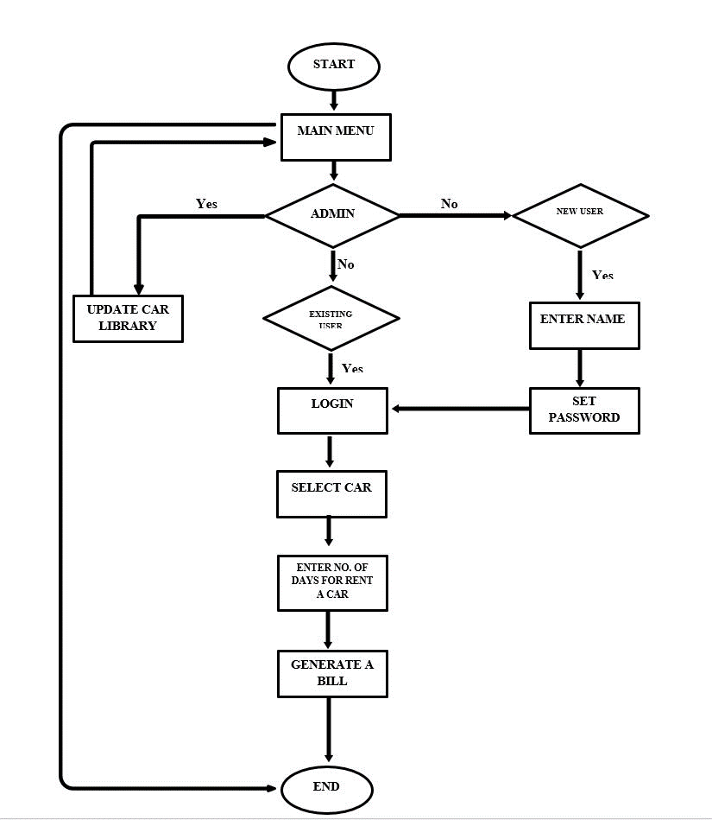
MODULES ARCHITECTURE

Slide 9
THANKS

